Slide 1
(Class12-Class 14) Wrapping-up Mini-Poker 27 February 2020
cs4501/econ4730 Spring 2020
David Evans and Denis Nekipelov
https://uvammm.github.io

Slide 2
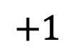
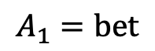
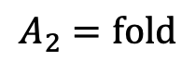
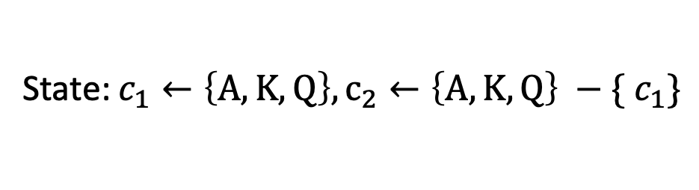
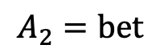
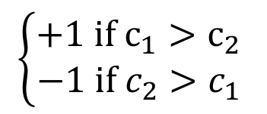
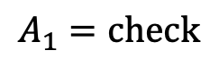
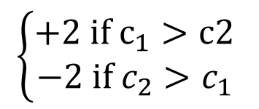
Recap: A-K-Q Poker
State: $c_{1}←\left\{A, K, Q\right\}, c_{2}←\left\{A, K, Q\right\} −\{ c_{1}\}$
$$A_{1}=check$$
$$A_{1}=bet$$
$$\left\{\begin{aligned}+1 if c_{1}>c_{2} \\ −1 if c_{2}>c_{1}\end{aligned}\right.$$
$$A_{2}=fold$$
$$A_{2}=bet$$
$$+1$$
$$\left\{\begin{aligned}+2 if c_{1}>c2 \\ −2 if c_{2}>c_{1}\end{aligned}\right.$$
Payoff for Player 1 shown; Player 2 payoff is negation.

Slide 3
P1: Never Bluff_{Q}
Player 1: |  |  | A | K | Q
 |  |  | Bet | Check | Check
Player 2 | A | Call |  | -1 | -1
 | K | Call | +2 |  | -1
 |  | Fold | +1 | +1 | -
 | Q | Fold | +1 | +1

Slide 4
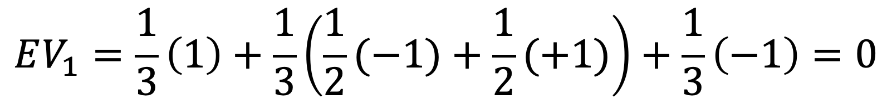
P1: Never Bluff_{Q}
Player 1: |  |  | A | K | Q
 |  |  | Bet | Check | Check
Player 2 | A | Call |  | -1 | -1
 | K | Call | +2 |  | -1
 |  | Fold | +1 | +1 | -
 | Q | Fold | +1 | +1
P2: Never Call_{K}
$$EV_{1}=\frac{1}{3}\left(1\right)+\frac{1}{3}\left(\frac{1}{2}(−1)+\frac{1}{2}(+1)\right)+\frac{1}{3}\left(−1\right)=0$$

Slide 5
P1: Always Bluff_{Q}
Player 1: |  |  | A | K | Q
 |  |  | Bet | Check | Bet
Player 2 | A | Call |  | -1 | -2
 | K | Call | +2 |  | -2
 |  | Fold | +1 | +1 | +1
 | Q | Fold | +1 | +1

Slide 6
P1: Always Bluff_{Q}
Player 1: |  |  | A | K | Q
 |  |  | Bet | Check | Bet
Player 2 | A | Call |  | -1 | -2
 | K | Call | +2 |  | -2
 |  | Fold | +1 | +1 | +1
 | Q | Fold | +1 | +1
P2: Always Call_{K}
$$EV_{1}=\frac{1}{3}\left(\frac{1}{2}\left(+2\right)+\frac{1}{2}(+1)\right)+\frac{1}{3}\left(\frac{1}{2}(−1)+\frac{1}{2}(+1)\right)+\frac{1}{3}\left(\frac{1}{2}\left(−2\right)+\frac{1}{2}(−2) \right)=−\frac{1}{6}$$

Slide 7
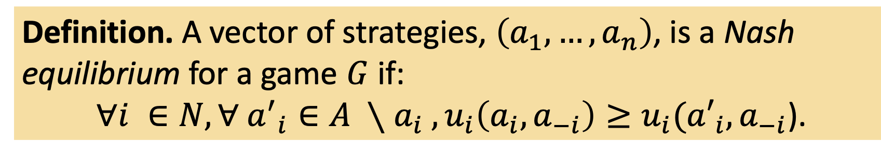
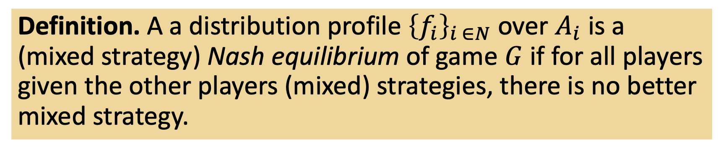
Nash Equilibrium
Definition. A vector of strategies, $\left(a_{1},…, a_{n}\right)$, is a Nash equilibrium for a game $G$ if:
$∀i ∈N,∀ {a^{′}}_{i}∈A ∖a_{i} , u_{i}\left(a_{i}, a_{−i}\right)≥u_{i}({a′}_{i}, a_{−i}$).
Definition. A a distribution profile ${\left\{f_{i}\right\}}_{i ∈N}$ over $A_{i}$ is a (mixed strategy) Nash equilibrium of game $G$ if for all players given the other players (mixed) strategies, there is no better mixed strategy.

Slide 8
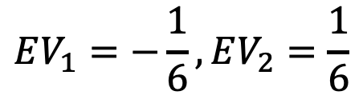
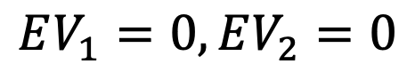
Mixed Strategy
Player 1: |  |  | A | K | Q
 |  |  | Bet | Check | Check
Player 2 | A | Call |  | -1 | -1
 | K | Fold/Call | +1 |  | -1
 | Q | Fold | +1 | +1
Player 1: |  |  | A | K | Q
 |  |  | Bet | Check | Bet
Player 2 | A | Call |  | -1 | -2
 | K | Call | +2 |  | -2
 | Q | Fold | +1 | +1
Never Bluff
Always Bluff
$$EV_{1}=0, EV_{2}=0$$
$$EV_{1}=−\frac{1}{6}, EV_{2}=\frac{1}{6}$$
Pure strategy: always do the same action for a given input state.
Mixed strategy: probabilistically select from a set of pure strategies.

Slide 9
Nash Equilibrium
Player 1 is choosing the best action she can, taking into account Player 2’s strategy.
Player 2 is choosing the best action she can, taking into about Player 1’s strategy.
Neither player can improve their expected value by deviating from the strategy.
Hence, to find the best strategy for Player 1, we need to find a strategy that makes Player 2 indifferent between her options.

Slide 10
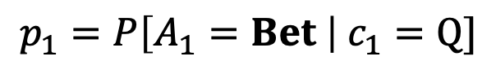
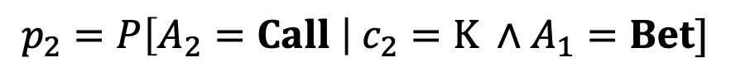
Player 1 |  |  | A | K | Q
Player 2 |  |  | Bet | Check | Check | Bet
 | A | Call |  | -1 | -1 | -2
 | K | Call | +2 |  | -1 | -2
 |  | Fold | +1 |  | -1 | +1
 | Q | Fold | +1 | +1
$$p_{1}=P\left[A_{1}=Bet \right| c_{1}=Q]$$
$$p_{2}=P\left[A_{2}=Call \right| c_{2}=K ∧A_{1}=Bet]$$
Notes:
https://www.wolframalpha.com/input/?i=1%2F3+%281%2F2+%28%2B1%29%2B+1%2F2%282p%2B%281%E2%88%92p%29%E2%88%991%29%29+%2B1%2F3+%281%2F2+%28%E2%88%922%29%2B1%2F2+%282p%2B%281%E2%88%92p%29%E2%88%991%29%29+%2B1%2F3+%281%2F2+%28%E2%88%921%29%2B1%2F2%28%E2%88%921%29+%29
https://www.wolframalpha.com/input/?i=1%2F3+%281%2F2+%28%2B1%29%2B+1%2F2%282p%2B%281%E2%88%92p%29%E2%88%991%29%29+%2B1%2F3+%281%2F2+%28%E2%88%921%29%2B1%2F2+%28p%E2%88%99%28%E2%88%921%29+%2B%281%E2%88%92p%29%E2%88%991%29%29+%2B1%2F3+%281%2F2+%28%E2%88%921%29%2B1%2F2%28%E2%88%921%29+%29
https://www.wolframalpha.com/input/?i=%28p%2F3%29-1%2F6+%3D+-p%2F6

Slide 11
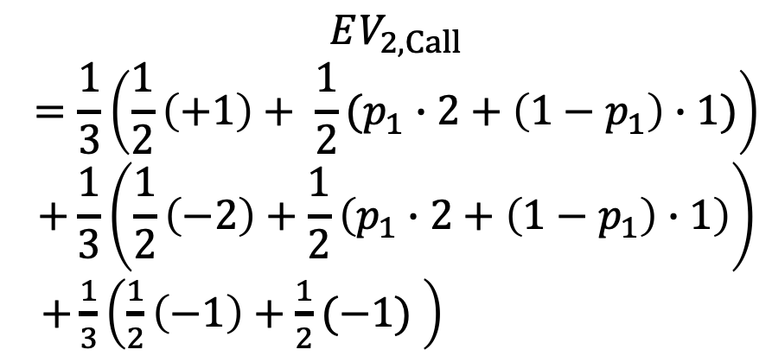
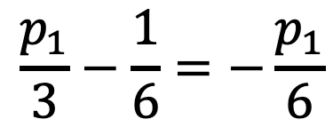
Player 1 |  |  | A | K | Q
Player 2 |  |  | Bet | Check | Check | Bet
 | A | Call |  | -1 | -1 | -2
 | K | Call | +2 |  | -1 | -2
 |  | Fold | +1 |  | -1 | +1
 | Q | Fold | +1 | +1
$$p_{1}=P\left[A_{1}=Bet \right| c_{1}=Q]$$
$$p_{2}=P\left[A_{2}=Call \right| c_{2}=K ∧A_{1}=Bet]$$
$$\frac{p_{1}}{3}−\frac{1}{6}=−\frac{p_{1}}{6}$$
https://www.wolframalpha.com/input/?i=%28p%2F3%29-1%2F6+%3D+-p%2F6
$$EV_{2,Call}$$
$$=\frac{1}{3}\left(\frac{1}{2}\left(+1\right)+ \frac{1}{2}(p_{1}∙2+\left(1−p_{1}\right)∙1)\right)$$
$$+\frac{1}{3}\left(\frac{1}{2}\left(−2\right)+\frac{1}{2}\left(p_{1}∙2+\left(1−p_{1}\right)∙1\right)\right)$$
$+\frac{1}{3}\left(\frac{1}{2}\left(−1\right)+\frac{1}{2}(−1) \right)=\frac{p_{1}}{3}−\frac{1}{6}$
solve
Notes:
https://www.wolframalpha.com/input/?i=1%2F3+%281%2F2+%28%2B1%29%2B+1%2F2%282p%2B%281%E2%88%92p%29%E2%88%991%29%29+%2B1%2F3+%281%2F2+%28%E2%88%922%29%2B1%2F2+%282p%2B%281%E2%88%92p%29%E2%88%991%29%29+%2B1%2F3+%281%2F2+%28%E2%88%921%29%2B1%2F2%28%E2%88%921%29+%29
https://www.wolframalpha.com/input/?i=1%2F3+%281%2F2+%28%2B1%29%2B+1%2F2%282p%2B%281%E2%88%92p%29%E2%88%991%29%29+%2B1%2F3+%281%2F2+%28%E2%88%921%29%2B1%2F2+%28p%E2%88%99%28%E2%88%921%29+%2B%281%E2%88%92p%29%E2%88%991%29%29+%2B1%2F3+%281%2F2+%28%E2%88%921%29%2B1%2F2%28%E2%88%921%29+%29
https://www.wolframalpha.com/input/?i=%28p%2F3%29-1%2F6+%3D+-p%2F6

Slide 12
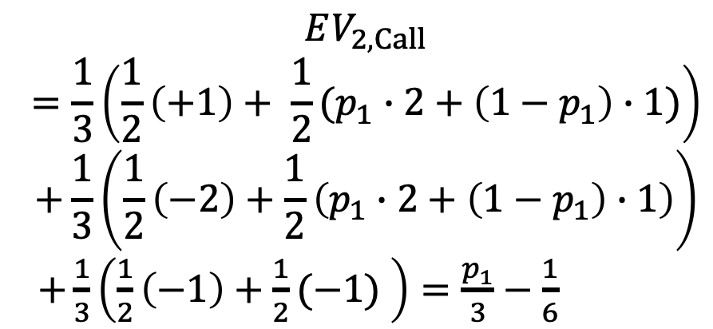
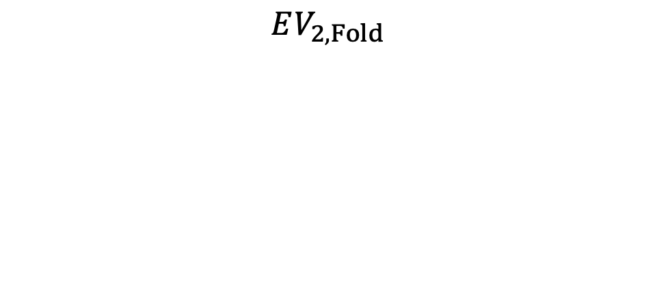
Player 1 |  |  | A | K | Q
Player 2 |  |  | Bet | Check | Check | Bet
 | A | Call |  | -1 | -1 | -2
 | K | Call | +2 |  | -1 | -2
 |  | Fold | +1 |  | -1 | +1
 | Q | Fold | +1 | +1
$$p_{1}=P\left[A_{1}=Bet \right| c_{1}=Q]$$
$$p_{2}=P\left[A_{2}=Call \right| c_{2}=K ∧A_{1}=Bet]$$
$$\frac{p_{1}}{3}−\frac{1}{6}=−\frac{p_{1}}{6}$$
https://www.wolframalpha.com/input/?i=%28p%2F3%29-1%2F6+%3D+-p%2F6
$$EV_{2,Call}$$
$$=\frac{1}{3}\left(\frac{1}{2}\left(+1\right)+ \frac{1}{2}(p_{1}∙2+\left(1−p_{1}\right)∙1)\right)$$
$$+\frac{1}{3}\left(\frac{1}{2}\left(−2\right)+\frac{1}{2}\left(p_{1}∙2+\left(1−p_{1}\right)∙1\right)\right)$$
$+\frac{1}{3}\left(\frac{1}{2}\left(−1\right)+\frac{1}{2}(−1) \right)=\frac{p_{1}}{3}−\frac{1}{6}$
$$EV_{2,Fold}$$
$$=\frac{1}{3}\left(\frac{1}{2}\left(+1\right)+ \frac{1}{2}(p_{1}∙2+\left(1−p_{1}\right)∙1)\right)$$
$$+\frac{1}{3}\left(\frac{1}{2}\left(−1\right)+\frac{1}{2}\left(p_{1}∙(−1) +\left(1−p_{1}\right)∙1\right)\right)$$
$$+\frac{1}{3}\left(\frac{1}{2}\left(−1\right)+\frac{1}{2}(−1) \right)=−\frac{p_{1}}{6}$$
solve
Notes:
https://www.wolframalpha.com/input/?i=1%2F3+%281%2F2+%28%2B1%29%2B+1%2F2%282p%2B%281%E2%88%92p%29%E2%88%991%29%29+%2B1%2F3+%281%2F2+%28%E2%88%922%29%2B1%2F2+%282p%2B%281%E2%88%92p%29%E2%88%991%29%29+%2B1%2F3+%281%2F2+%28%E2%88%921%29%2B1%2F2%28%E2%88%921%29+%29
https://www.wolframalpha.com/input/?i=1%2F3+%281%2F2+%28%2B1%29%2B+1%2F2%282p%2B%281%E2%88%92p%29%E2%88%991%29%29+%2B1%2F3+%281%2F2+%28%E2%88%921%29%2B1%2F2+%28p%E2%88%99%28%E2%88%921%29+%2B%281%E2%88%92p%29%E2%88%991%29%29+%2B1%2F3+%281%2F2+%28%E2%88%921%29%2B1%2F2%28%E2%88%921%29+%29
https://www.wolframalpha.com/input/?i=%28p%2F3%29-1%2F6+%3D+-p%2F6

Slide 13
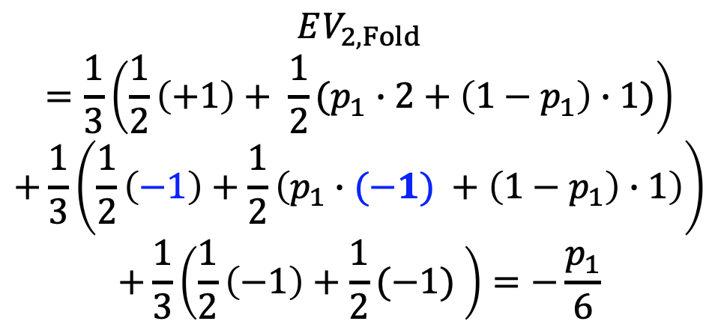
Player 1 |  |  | A | K | Q
Player 2 |  |  | Bet | Check | Check | Bet
 | A | Call |  | -1 | -1 | -2
 | K | Call | +2 |  | -1 | -2
 |  | Fold | +1 |  | -1 | +1
 | Q | Fold | +1 | +1
$$p_{1}=P\left[A_{1}=Bet \right| c_{1}=Q]$$
$$p_{2}=P\left[A_{2}=Call \right| c_{2}=K ∧A_{1}=Bet]$$
$$\frac{p_{1}}{3}−\frac{1}{6}=−\frac{p_{1}}{6}$$
https://www.wolframalpha.com/input/?i=%28p%2F3%29-1%2F6+%3D+-p%2F6
$$EV_{2,Call}$$
$$=\frac{1}{3}\left(\frac{1}{2}\left(+1\right)+ \frac{1}{2}(p_{1}∙2+\left(1−p_{1}\right)∙1)\right)$$
$$+\frac{1}{3}\left(\frac{1}{2}\left(−2\right)+\frac{1}{2}\left(p_{1}∙2+\left(1−p_{1}\right)∙1\right)\right)$$
$+\frac{1}{3}\left(\frac{1}{2}\left(−1\right)+\frac{1}{2}(−1) \right)=\frac{p_{1}}{3}−\frac{1}{6}$
$$EV_{2,Fold}$$
$$=\frac{1}{3}\left(\frac{1}{2}\left(+1\right)+ \frac{1}{2}(p_{1}∙2+\left(1−p_{1}\right)∙1)\right)$$
$$+\frac{1}{3}\left(\frac{1}{2}\left(−1\right)+\frac{1}{2}\left(p_{1}∙(−1) +\left(1−p_{1}\right)∙1\right)\right)$$
$$+\frac{1}{3}\left(\frac{1}{2}\left(−1\right)+\frac{1}{2}(−1) \right)=−\frac{p_{1}}{6}$$
solve
Notes:
https://www.wolframalpha.com/input/?i=1%2F3+%281%2F2+%28%2B1%29%2B+1%2F2%282p%2B%281%E2%88%92p%29%E2%88%991%29%29+%2B1%2F3+%281%2F2+%28%E2%88%922%29%2B1%2F2+%282p%2B%281%E2%88%92p%29%E2%88%991%29%29+%2B1%2F3+%281%2F2+%28%E2%88%921%29%2B1%2F2%28%E2%88%921%29+%29
https://www.wolframalpha.com/input/?i=1%2F3+%281%2F2+%28%2B1%29%2B+1%2F2%282p%2B%281%E2%88%92p%29%E2%88%991%29%29+%2B1%2F3+%281%2F2+%28%E2%88%921%29%2B1%2F2+%28p%E2%88%99%28%E2%88%921%29+%2B%281%E2%88%92p%29%E2%88%991%29%29+%2B1%2F3+%281%2F2+%28%E2%88%921%29%2B1%2F2%28%E2%88%921%29+%29
https://www.wolframalpha.com/input/?i=%28p%2F3%29-1%2F6+%3D+-p%2F6

Slide 14
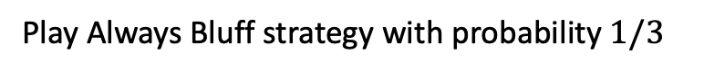
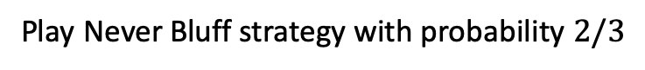
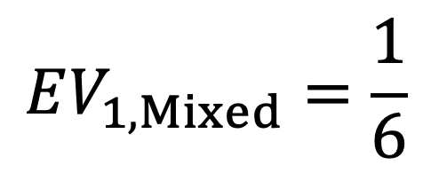
Winning the AKQ Game
Player 1: |  |  | A | K | Q
 |  |  | Bet | Check | Check
Player 2 | A | Call |  | -1 | -1
 | K | Fold/Call | +1 |  | -1
 | Q | Fold | +1 | +1
Player 1: |  |  | A | K | Q
 |  |  | Bet | Check | Bet
Player 2 | A | Call |  | -1 | -2
 | K | Call | +2 |  | -2
 | Q | Fold | +1 | +1
Play Never Bluff strategy with probability $2/3$
Play Always Bluff strategy with probability $1/3$
$$EV_{1, Mixed}=\frac{1}{6}$$

